Slide 1
• Depresio •
AI-Powered Virtual Stress Management Assistant for IT Professionals - A Comprehensive Solution for Achieving Work-Life Balance and Reducing Stress for IT Professionals
Here is where your presentation begins

Slide 2
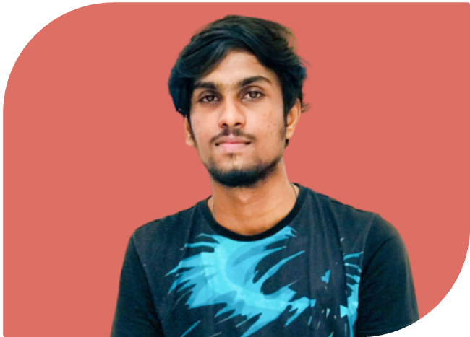
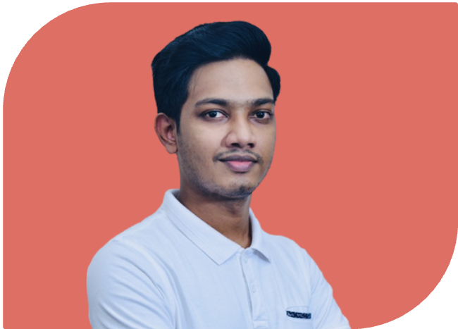
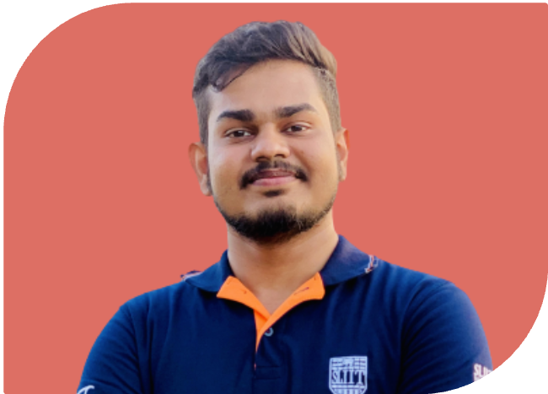

MEET OUR TEAM
Dharmagunarathna
S J
Premarathne
H M P D
Harishchandra
M A D D K
Ranasgala
R C S
IT20210892
IT20211578
IT20211264
IT20128722

Slide 3
INTRODUCTION
An AI-Powered Virtual Leisure and Work Assistant is the suggested remedy for the problems that IT workers deal with daily.
The platform offers tools for determining stress levels, individualized treatment programs, relaxation techniques, exercise, time-management approaches, and music therapy.
The system makes use of well-known machine learning and natural language processing frameworks and is programmed in Python, a flexible and widely used programming language.
The proposed solution aims to give IT professionals a thorough and individualized approach to stress management and healthier work-life balance, thereby enhancing their quality of life.

Slide 4
RESEARCH QUESTION
The modern IT landscape is characterized by rapid technological advancements, tight deadlines, and high-pressure work environments, which can make it challenging for IT professionals to maintain a healthy work-life balance.
Severe stress and the demands of a fast-paced work environment can result in burnout, lower productivity, and health problems.
IT employment frequently entails intense problem-solving and long hours of sitting at a desk, exacerbating the challenges faced by IT professionals.
There is a growing need for an effective solution to help IT professionals manage their stress and achieve a healthy work-life balance.
The goal is to develop a practical, impactful, and scalable solution that empowers IT professionals to take control of their well-being and achieve a healthier, more satisfying work-life balance.

Slide 5
RESEARCH OBJECTIVE
AI-Powered Virtual Leisure and Work Assistant for IT professionals.
Personalized recommendations for stress reduction and work-life balance
Stress level identification through emotion detection
Personalized treatment plan, including relaxation techniques and time-management strategies
Music therapy using AI analysis of users' preferences and emotional states

Slide 6
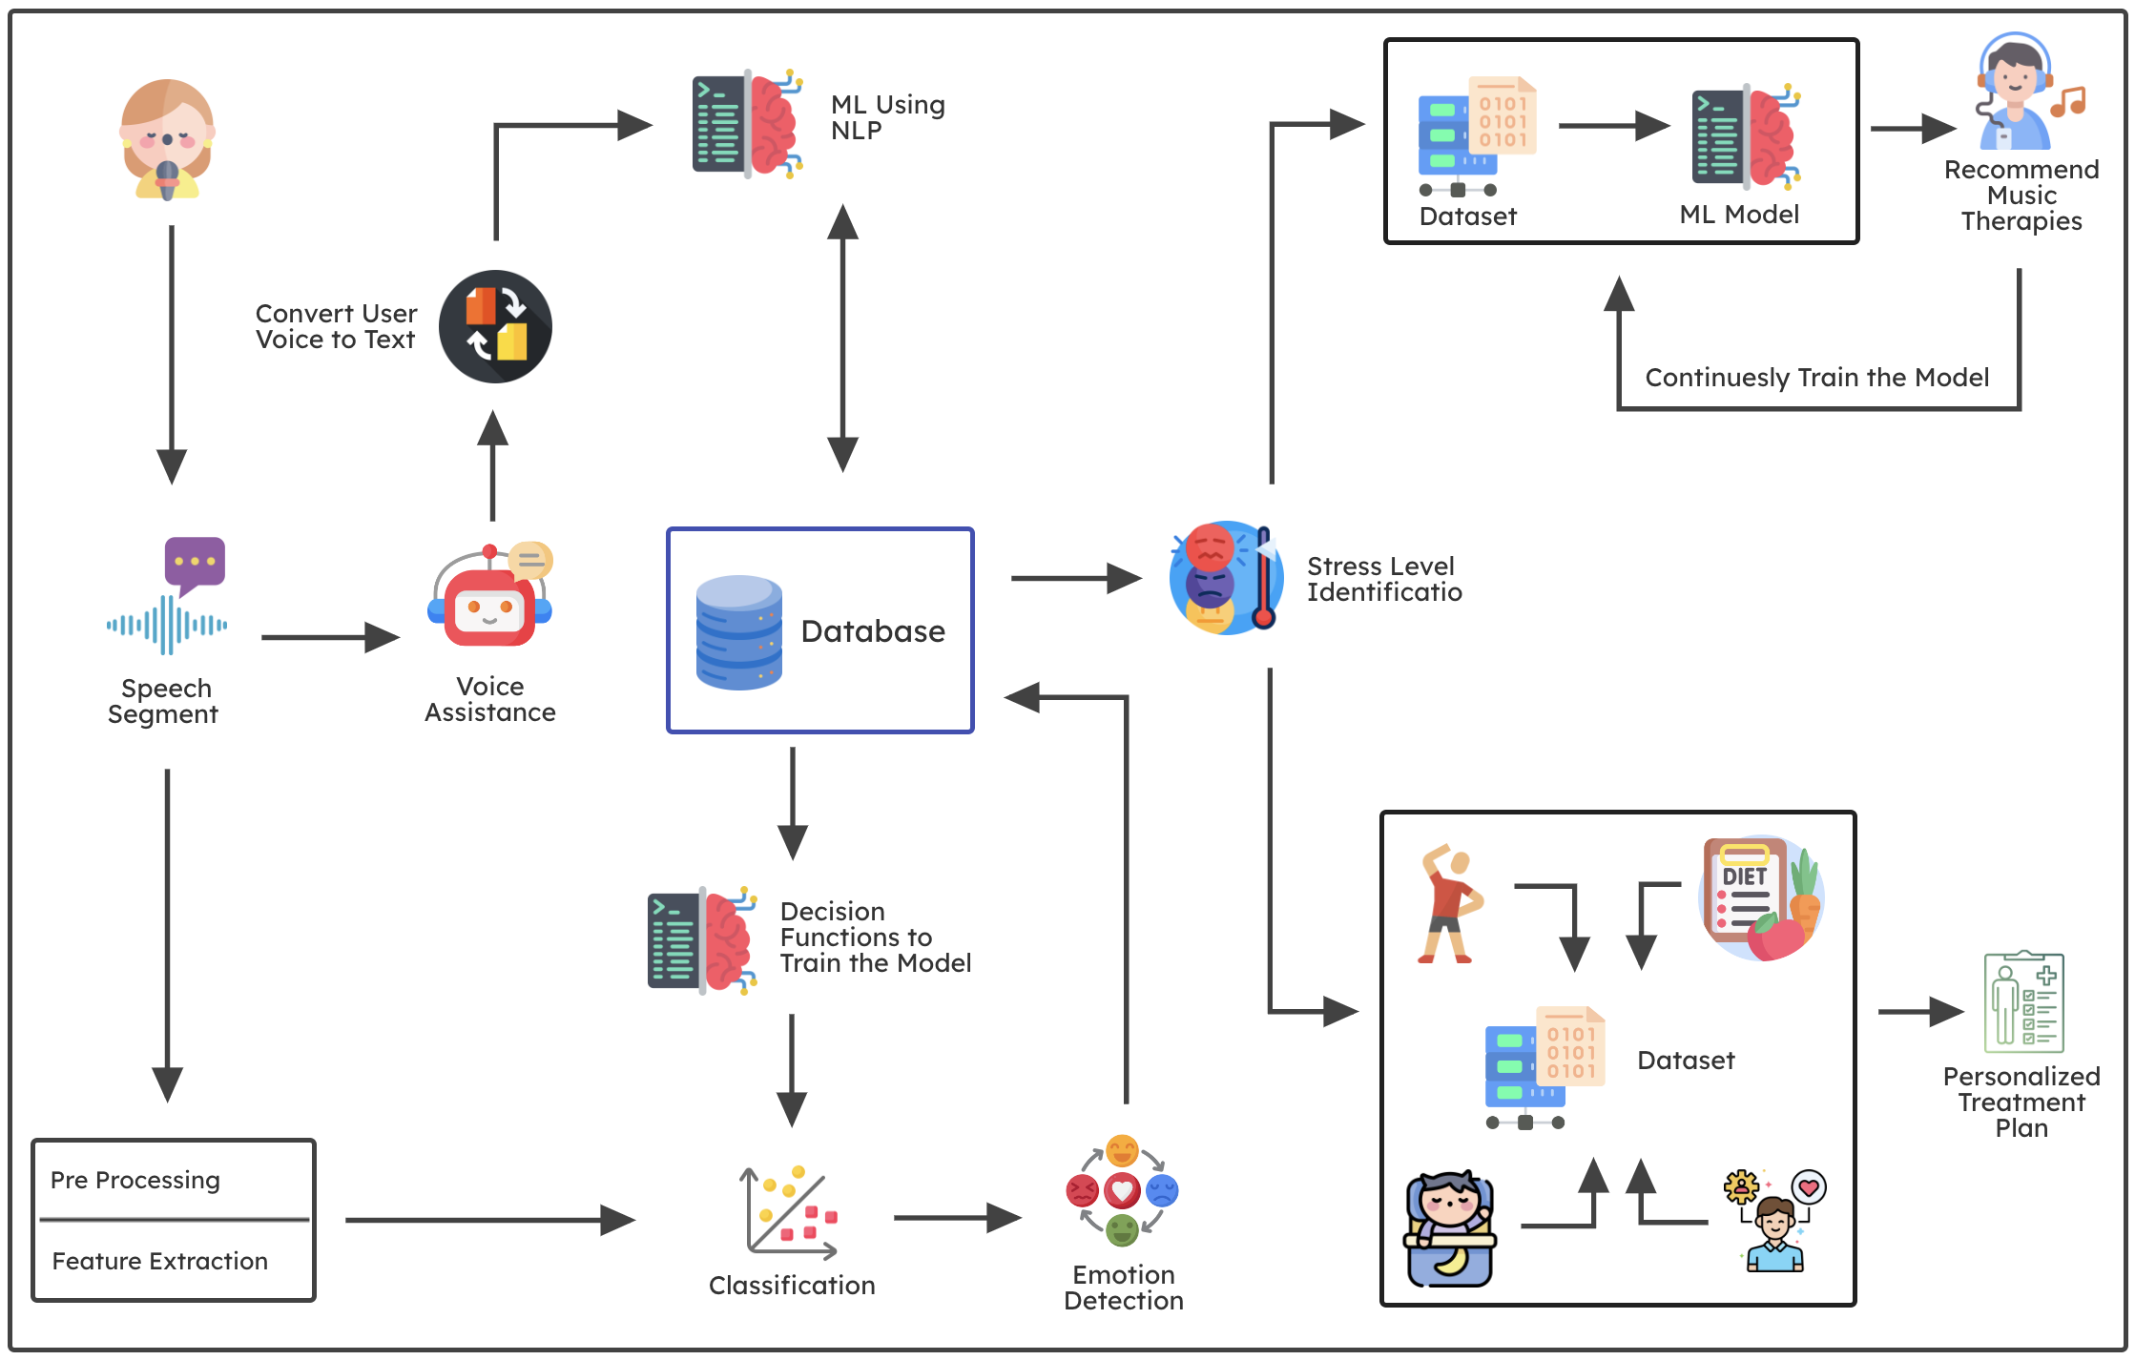
OVERALL SYSTEM DIAGRAM

Slide 7

01
Dharmagunarathna S J
IT20210892
Information Technology
IT20210892 | Dharmagunarathna S.J. | TMP-23-116

Slide 8
RESEARCH BACKGROUND
Personalized virtual assistants are becoming more prevalent in our daily lives. [1]
Voice recognition technology has improved significantly in recent years. [2]
Stress is a common issue among IT professionals, particularly those who spend long hours working in front of a computer. [3]
IT20210892 | Dharmagunarathna S.J. | TMP-23-116

Slide 9
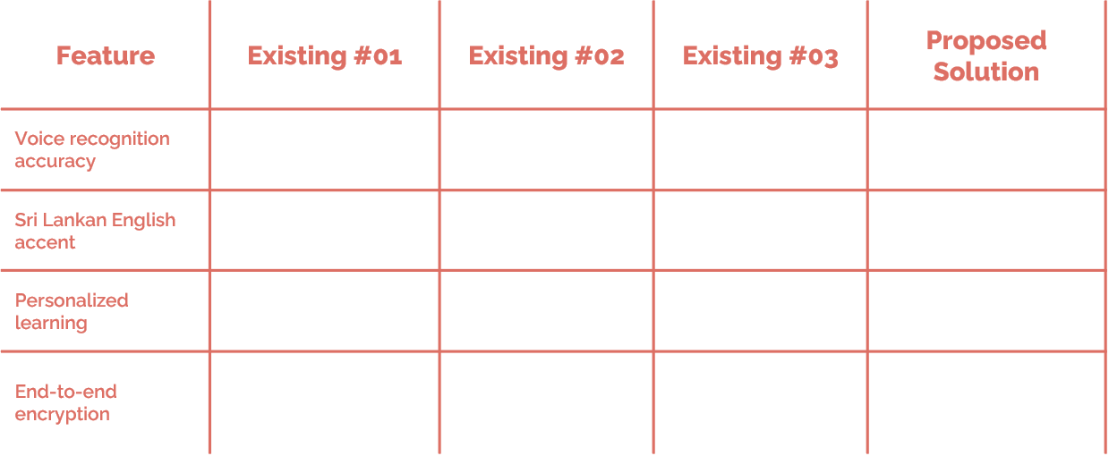
RESEARCH GAP
Limited research has been done on creating AI assistants for stress reduction and leisure activities specifically for Sri Lankan IT professionals.
None of the existing solutions provide a comprehensive AI assistant with high accuracy for detecting stress levels through vocal emotion recognition specifically for the Sri Lankan English accent.
Existing solutions do not offer a personalized and continuous learning AI assistant that can provide stress reduction treatments, music therapies, and leisure activities, all in one platform.
IT20210892 | Dharmagunarathna S.J. | TMP-23-116

Slide 10

RESEARCH QUESTION
Can we develop a personalized virtual voice assistant that accurately detects and reduces stress levels of Sri Lankan IT professionals, and can it be integrated into their work routine to promote a healthier work-life balance?
IT20210892 | Dharmagunarathna S.J. | TMP-23-116

Slide 11

RESEARCH OBJECTIVES
To develop a personalized virtual assistant that accurately detects a user's stress level based on their voice input.
To tailor the virtual assistant to be more accurate for Sri Lankan English accents.
To implement a continuous learning mechanism to improve the accuracy of the virtual assistant over time.
To enhance the security of the conversation through end-to-end encryption.
IT20210892 | Dharmagunarathna S.J. | TMP-23-116

Slide 12
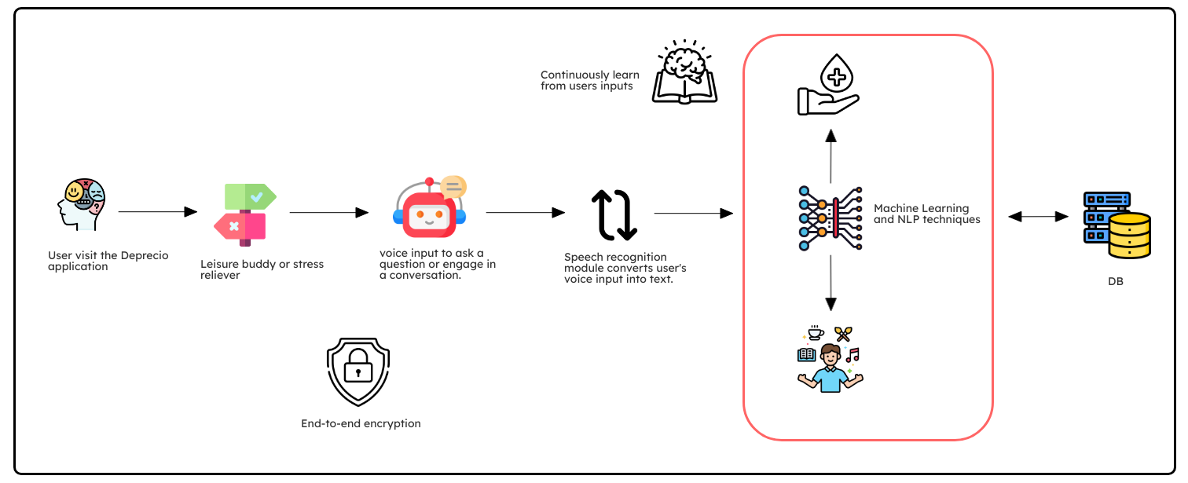
METHODOLOGY SYSTEM DIAGRAM
IT20210892 | Dharmagunarathna S.J. | TMP-23-116

Slide 13
TECHNOLOGIES, TECHNIQUES & ALGORITHMS
Technologies | Algorithms | Techniques
React JS Python Tensor Flow Keras Firebase | CNN – voice recognition K-Means – unsupervised learning for personalized continuous learning | Natural Language Processing (NLP) – analyze voice inputs and extract meaningful information Active Learning – interact with the user and actively learn from user inputs
IT20210892 | Dharmagunarathna S.J. | TMP-23-116

Slide 14

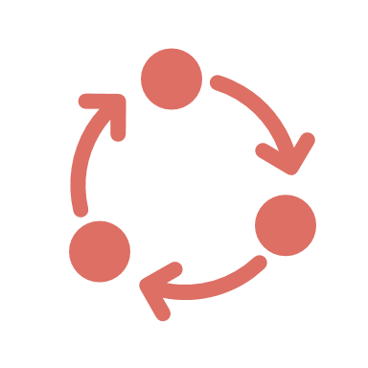
SYSTEM REQUIREMENTS
Functional Requirements
Non - Functional Requirements
Voice recognition and transcription
Accuracy
Personalized learning and continuous improvement
Reliability
Security measures for end-to-end encryption
Security
IT20210892 | Dharmagunarathna S.J. | TMP-23-116

Slide 15
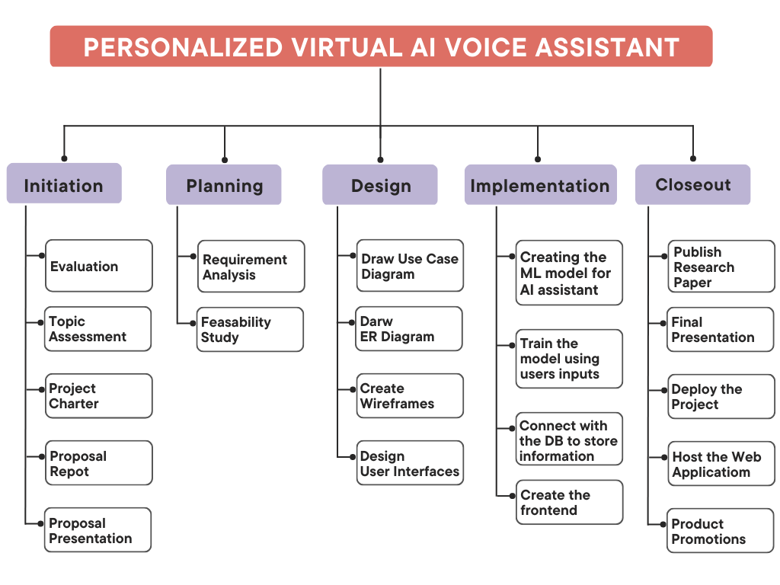
WORK BREAKDOWN
You can replace the image on the screen with your own work. Just right-click on it and select “Replace image”
IT20210892 | Dharmagunarathna S.J. | TMP-23-116

Slide 16
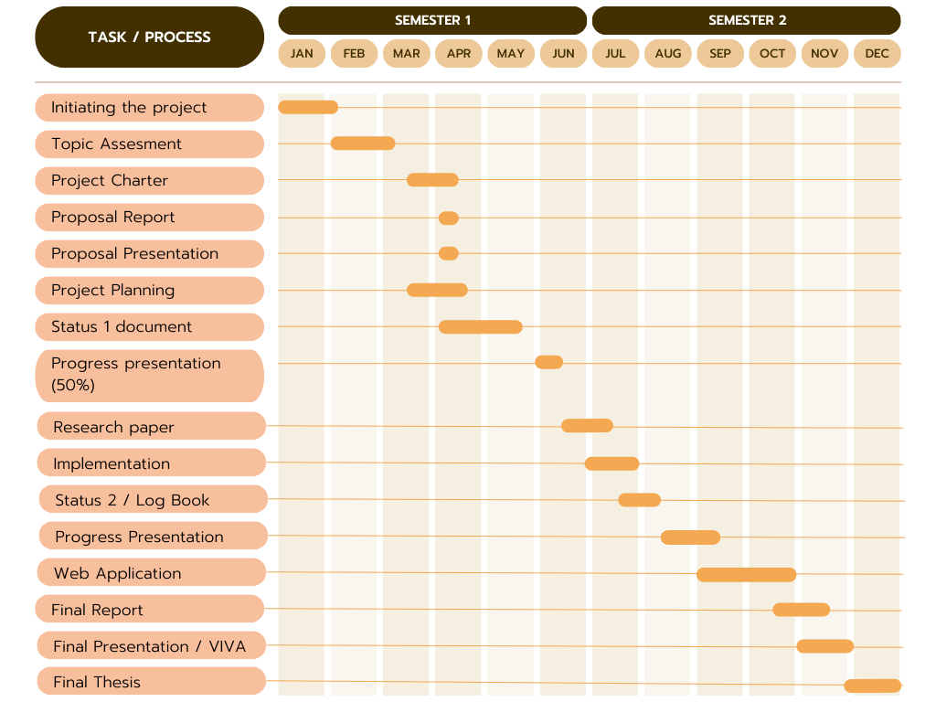
GANTT CHART
You can replace the image on the screen with your own work. Just right-click on it and select “Replace image”
IT20210892 | Dharmagunarathna S.J. | TMP-23-116

Slide 17
REFFERENCES
https://www.researchgate.net/profile/Mohsen-Ahmadian/publication/322665841_AI-Based_Voice_Assistant_Systems_Evaluating_from_the_Interaction_and_Trust_Perspectives/links/5a67992b0f7e9b76ea8f054f/AI-Based-Voice-Assistant-Systems-Evaluating-from-the-Interaction-and-Trust-Perspectives.pdf
https://ieeexplore.ieee.org/abstract/document/9210344/
https://iris.unito.it/handle/2318/1769694
https://www.sciencedirect.com/science/article/pii/S0926580522001935
https://dl.acm.org/doi/abs/10.1145/3351556.3351588
IT20210892 | Dharmagunarathna S.J. | TMP-23-116

Slide 18

02
Premarathne H M P D
Premarathne H M P D
IT20211578
IT20211578
Information Technology
Information Technology
IT20211578 | Premarathne H M P D | TMP-23-116

Slide 19
RESEARCH BACKGROUND
IT professionals face a high level of stress due to their demanding work and unbalanced lifestyle than other job titles.[1]
Stress can have a negative impact on their physical and mental health, as well as their productivity.[2]
Identifying stress levels based on vocal emotion can provide an efficient and non-intrusive method for stress management.[4]
IT20211578 | Premarathne H M P D | TMP-23-116

Slide 20
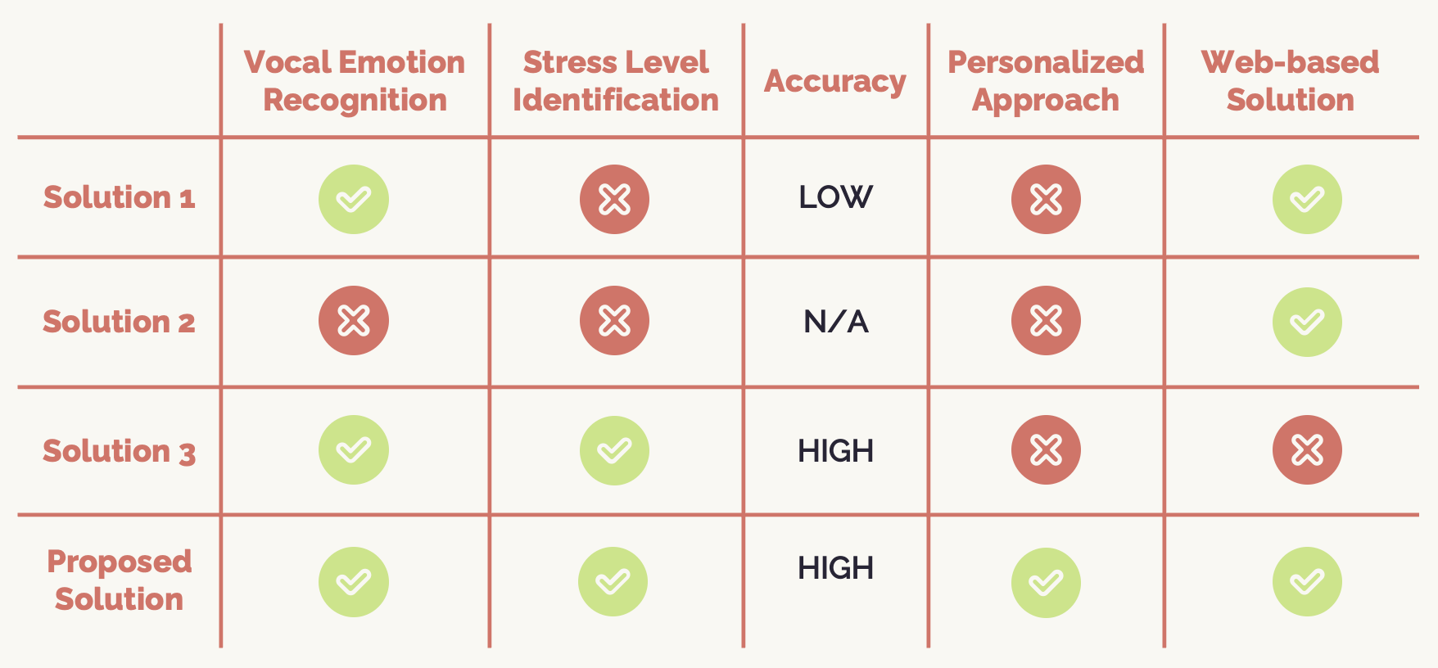
RESEARCH GAP
Limited researches has been done on stress detection using vocal emotion in Sri Lankan IT professionals.
None of the existing solutions provide a comprehensive solution for stress level identification with high accuracy, personalized approach, and a web-based platform for easy access. [3]
Existing solutions do not offer both vocal emotion recognition and stress level identification, in a comprehensive manner.
The proposed solution addresses all of these gaps.
IT20211578 | Premarathne H M P D | TMP-23-116

Slide 21
RESEARCH QUESTION
Can machine learning algorithms accurately identify stress levels based on vocal emotion in Sri Lankan IT professionals?
IT20211578 | Premarathne H M P D | TMP-23-116

Slide 22
RESEARCH OBJECTIVES
Develop and train a machine learning algorithm to accurately recognize emotions by voice inputs.
Continuously train the model to detect emotions using unsupervised learning method.
Evaluate the accuracy of the machine learning algorithm in identifying stress levels based on vocal emotions.
Compare the accuracy of the machine learning algorithm with existing methods for stress level identification, such as self-reporting or physiological measurements.
IT20211578 | Premarathne H M P D | TMP-23-116

Slide 23
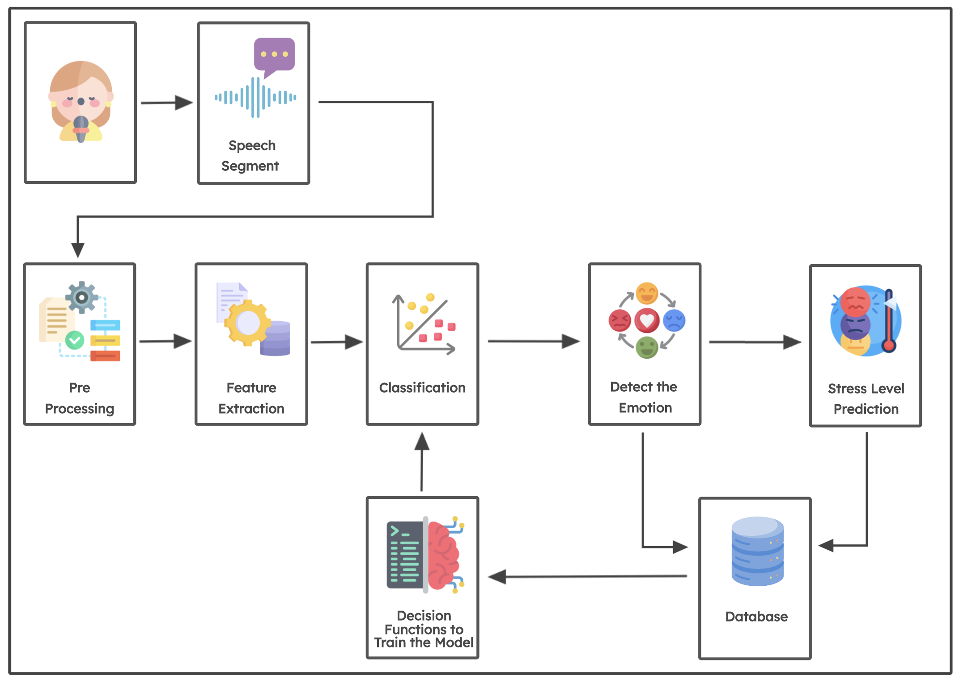
METHODOLOGY SYSTEM DIAGRAM
IT20211578 | Premarathne H M P D | TMP-23-116

Slide 24
TECHNOLOGIES, TECHNIQUES & ALGORITHMS
Technologies | Algorithms | Techniques
React JS Python Tensor Flow Keras Firebase | K-Means CNN Random Forest | Feature extraction Data pre-processing
IT20211578 | Premarathne H M P D | TMP-23-116

Slide 25
SYSTEM REQUIREMENTS
Functional Requirements
Non - Functional Requirements
System should be able to pre-process the vocal emotion data using techniques
System shall have high accuracy in stress level identification based on vocal emotion recognition
System should be able to train and evaluate a machine learning algorithm for stress level identification
System shall be scalable to accommodate a large number of users
System should be able to provide stress level feedback to the user
System should be able respond fast to the users without latency
System should be able to display stress level trends over time and generate reports for each user
System shall have a user-friendly interface for ease of use.
IT20211578 | Premarathne H M P D | TMP-23-116

Slide 26
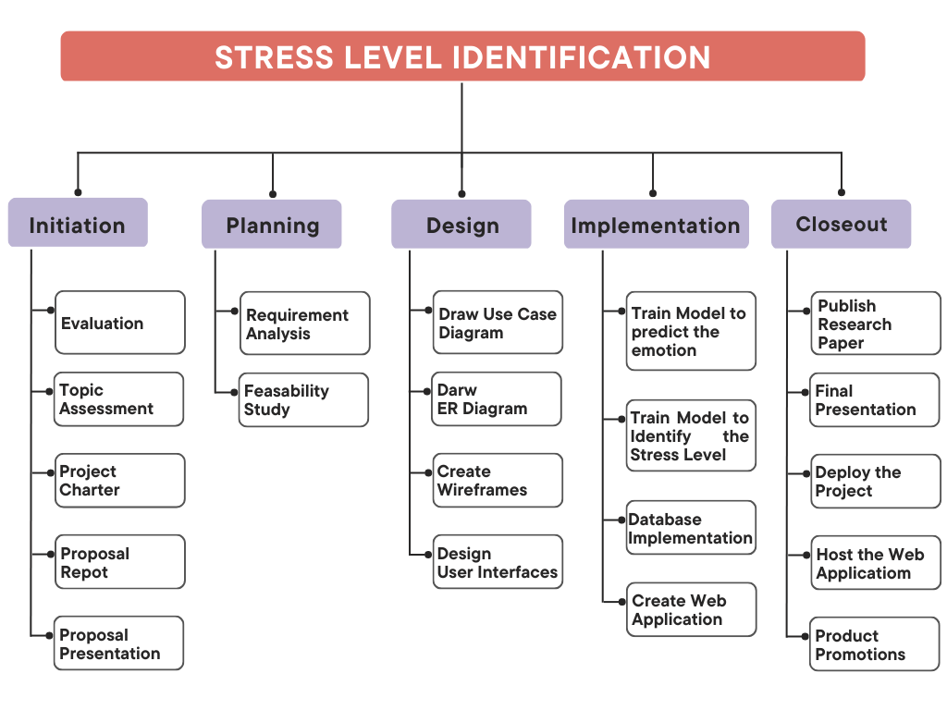
WORK BREAKDOWN
You can replace the image on the screen with your own work. Just right-click on it and select “Replace image”
IT20211578 | Premarathne H M P D | TMP-23-116

Slide 27
GANTT CHART
You can replace the image on the screen with your own work. Just right-click on it and select “Replace image”
IT20211578 | Premarathne H M P D | TMP-23-116

Slide 28
REFFERENCES
https://spacelift.io/blog/are-it-jobs-stressful IT’s Stressful. Ask DevOps, They’ll Know: Stress in the IT Sector [2022 Survey] [1]
https://www.ncbi.nlm.nih.gov/pmc/articles/PMC4439723/ Health problems and stress in Information Technology and Business Process Outsourcing employees [2]
https://www.worldscientific.com/doi/epdf/10.1142/9789812775320_0021 Multimodal Emotion Recognition [3]
https://www.cs.brandeis.edu/~marc/misc/proceedings/lrec-2008/pdf/336_paper.pdf Emotion Recognition from Speech: Stress Experiment [4]
IT20211578 | H M P D Premarathne | TMP-23-116

Slide 29

03
Harischandra M A D D K
IT20211264
Information Technology
IT20211264| Harischandra M.A.D.D.K | TMP-23-116

Slide 30
RESEARCH BACKGROUND
Stress is a common problem among IT professionals, and music therapy has been shown to be an effective stress reduction technique
Existing music therapy solutions are often not personalized and may not take into account the user's real-time emotional state.
Machine learning algorithms can be used to analyze user preferences and emotional state to create a personalized music therapy solution.
IT20211264| Harischandra M.A.D.D.K | TMP-23-116

Slide 31
RESEARCH GAP
Feature | Existing #01 | Existing #02 | Existing #03 | Proposed Solution
Personalized music therapy
User-friendly interface
Stress reduction evaluation
Web-based platform
Limited research on the use of music therapy specifically for Sri Lankan IT professionals
Lack of personalized music therapy solutions available
IT20211264| Harischandra M.A.D.D.K | TMP-23-116

Slide 32
RESEARCH QUESTION
Can a personalized music therapy playlist system be developed to reduce stress levels in Sri Lankan IT professionals?

Slide 33
RESEARCH OBJECTIVES
Develop a personalized music therapy playlist system using advanced music information retrieval techniques and machine learning algorithms
Analyze and select music tracks based on user preferences and therapeutic properties
Adapt to users' real-time emotional state to generate a personalized playlist that promotes stress reduction
Develop a user-friendly interface for browsing and listening to personalized playlists
Evaluate the impact of personalized music therapy on stress reduction through user testing and feedback
IT20211264| Harischandra M.A.D.D.K | TMP-23-116

Slide 34
TECHNOLOGIES, TECHNIQUES & ALGORITHMS
Technologies | Algorithms
React JS Python R Tensor Flow Keras | CNN (used for deep learning algorithm) SVM (used for classification and regression analysis) K-Means (unsupervised learning for personalized continuous learning)
IT20211264| Harischandra M.A.D.D.K | TMP-23-116

Slide 35
SYSTEM REQUIREMENTS
Functional Requirements
Non - Functional Requirements
Personalized music track recommendations
Performance
Usability
Train the Machin learning model acceding to the user behavior
Scalability
IT20211264| Harischandra M.A.D.D.K | TMP-23-116

Slide 36
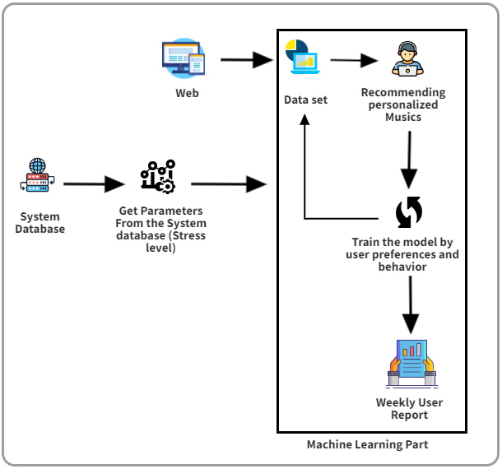
SYSTEM DIAGRAM
IT20211264| Harischandra M.A.D.D.K | TMP-23-116

Slide 37
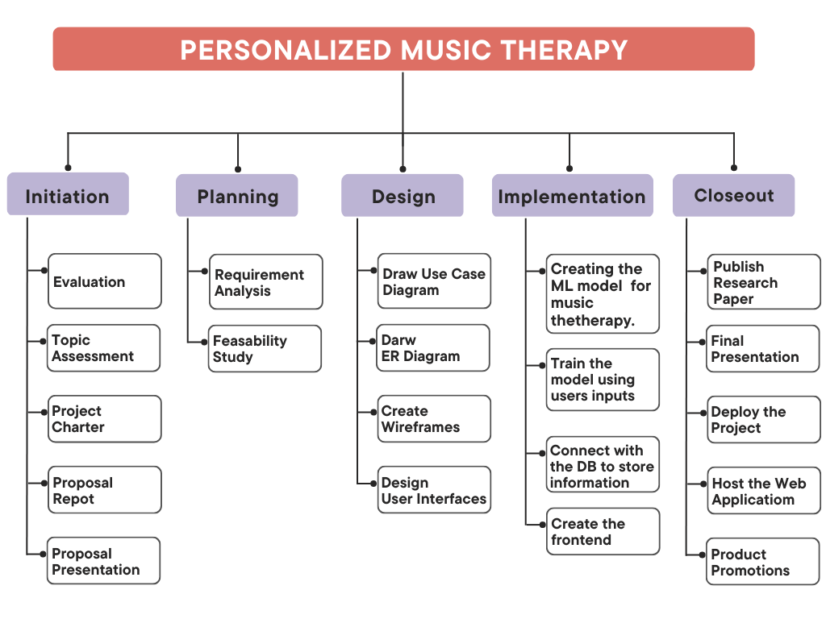
WORK BREAKDOWN
You can replace the image on the screen with your own work. Just right-click on it and select “Replace image”
IT20211264| Harischandra M.A.D.D.K | TMP-23-116

Slide 38
GANTT CHART
You can replace the image on the screen with your own work. Just right-click on it and select “Replace image”
IT20211264| Harischandra M.A.D.D.K | TMP-23-116

Slide 39
REFFERENCES
https://www.mdpi.com/2076-3417/11/19/8833
https://voices.no/index.php/voices/article/view/3308/3231
https://www.ncbi.nlm.nih.gov/pmc/articles/PMC6486188/
https://www.frontiersin.org/articles/10.3389/frai.2020.497864/full
https://www.ncbi.nlm.nih.gov/pmc/articles/PMC7861294/
IT20211264| Harischandra M.A.D.D.K | TMP-23-116

Slide 40

04
Ranasgala R C S
Ranasgala R C S
Premarathne H M P D
IT20128722
IT20211578
IT20128722
Information Technology
Information Technology
Information Technology
IT20128722 | R C S Ranasgala | TMP-23-116

Slide 41
RESEARCH BACKGROUND
This component provides a personalized treatment plan for Sri Lankan IT professionals who face significant stress due to their work and lifestyle.
Describe the reasons to stop the treatment here
Describe the reasons to stop the treatment here
Describe the reasons to stop the treatment here
Describe the reasons to stop the treatment here
The component aims to create a personalized treatment plan for Sri Lankan IT professionals, utilizing machine learning to provide tailored recommendations.
The treatment plan includes personalized recommendations with exercises and mindfulness practices, nutrition plan, sleep pattern, and stress management instructions.
IT20128722 | R C S Ranasgala | TMP-23-116

Slide 42
RESEARCH BACKGROUND
Personalized stress management recommendations via machine learning, based on user data, show promise in healthcare and marketing.
Describe the reasons to stop the treatment here
Describe the reasons to stop the treatment here
Describe the reasons to stop the treatment here
Describe the reasons to stop the treatment here
The web-based platform enables convenient and accessible access to personalized treatment plans from anywhere with an internet connection.
This research can benefit individuals and the community by reducing workplace stress, improving productivity, and increasing job satisfaction.
IT20128722 | R C S Ranasgala | TMP-23-116

Slide 43
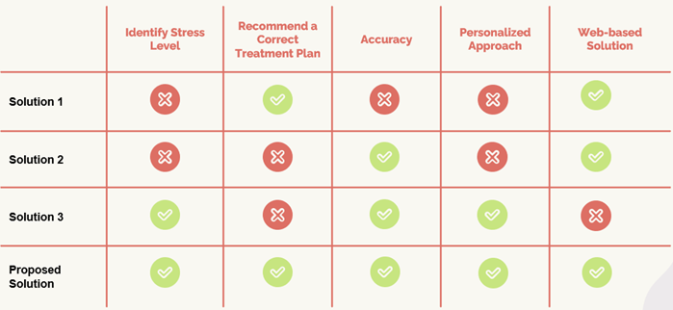
RESEARCH GAP
There is limited research on personalized stress reduction treatment plans for Sri Lankan IT professionals.
Existing stress management techniques may not be tailored to the unique needs of Sri Lankan IT professionals.
IT20128722 | R C S Ranasgala | TMP-23-116

Slide 44
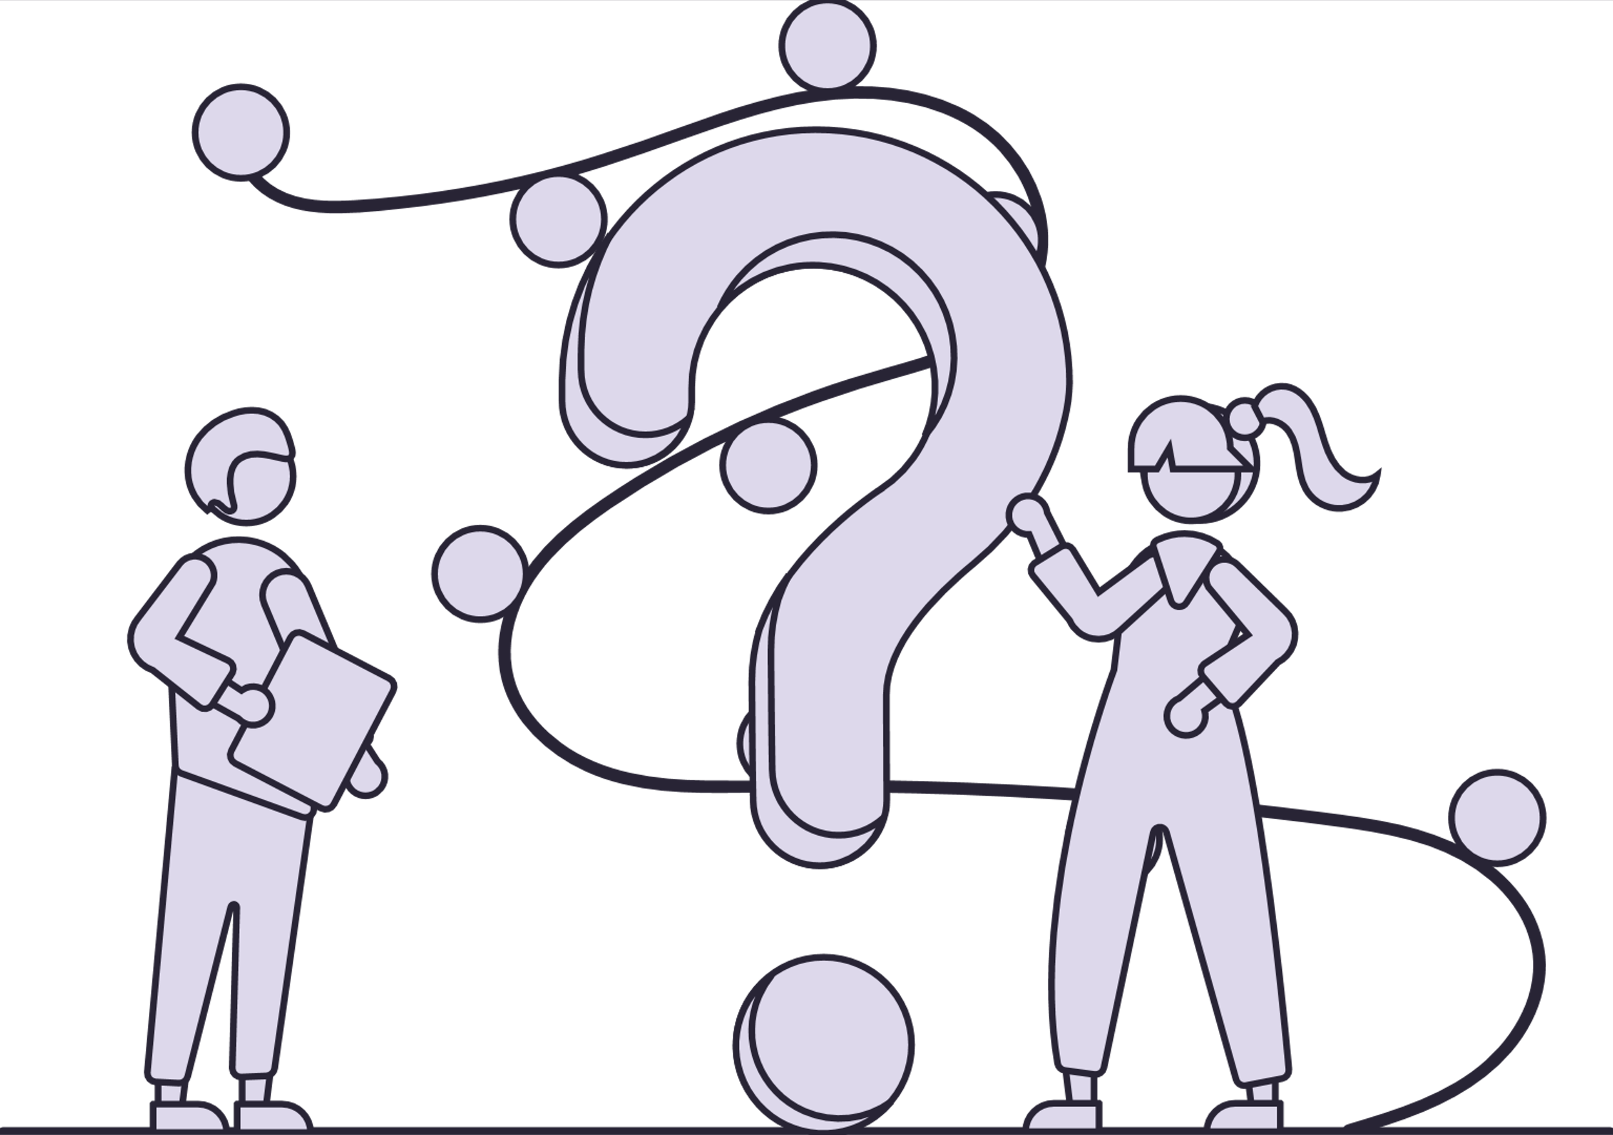
RESEARCH QUESTION
How to recommend correct personalized treatment plan for Sri Lankan IT professionals?
High stress levels and resulting health issues among Sri Lankan IT professionals.
IT20128722 | R C S Ranasgala | TMP-23-116

Slide 45
RESEARCH OBJECTIVES
Develop a web-based solution for personalized stress reduction treatment plans.
Use machine learning algorithms to recommend personalized exercises, mindfulness practices, nutrition plan, sleep pattern, and stress management techniques.
Evaluate the effectiveness of the personalized treatment plan in reducing stress levels.
IT20128722 | R C S Ranasgala | TMP-23-116

Slide 46
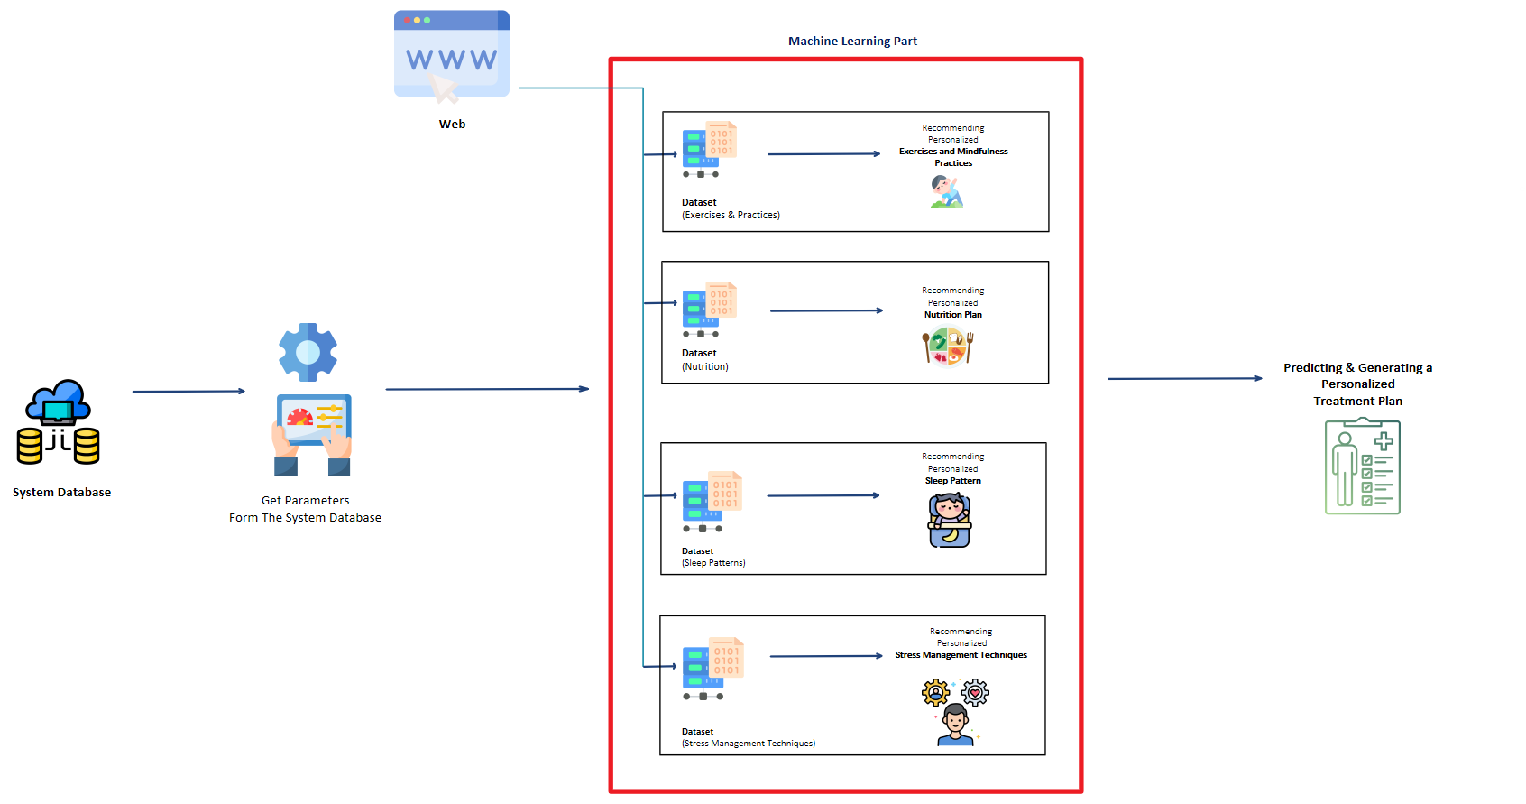
SYSTEM DIAGRAM
Describe the reasons to stop the treatment here
Describe the reasons to stop the treatment here
Describe the reasons to stop the treatment here
Describe the reasons to stop the treatment here
IT20128722 | R C S Ranasgala | TMP-23-116

Slide 47
TECHNOLOGIES AND ALGORITHMS
React JS
Python
Tensor Flow
Keras
K-Means
CNN
Random Forests
Technologies
Algorithms
IT20128722 | R C S Ranasgala | TMP-23-116

Slide 48
SYSTEM REQUIREMENTS
Functional Requirements
Non-Functional Requirements
System collect user data on exercises nutrition, sleep pattern and stress level.
Provide timely personalized recommendations
Analyze data using ML for personalized recommendations.
User-friendly and easy to navigate.
Generate personalized overall treatment plan.
Reliable and accurate personalized recommendations.
IT20128722 | R C S Ranasgala | TMP-23-116

Slide 49
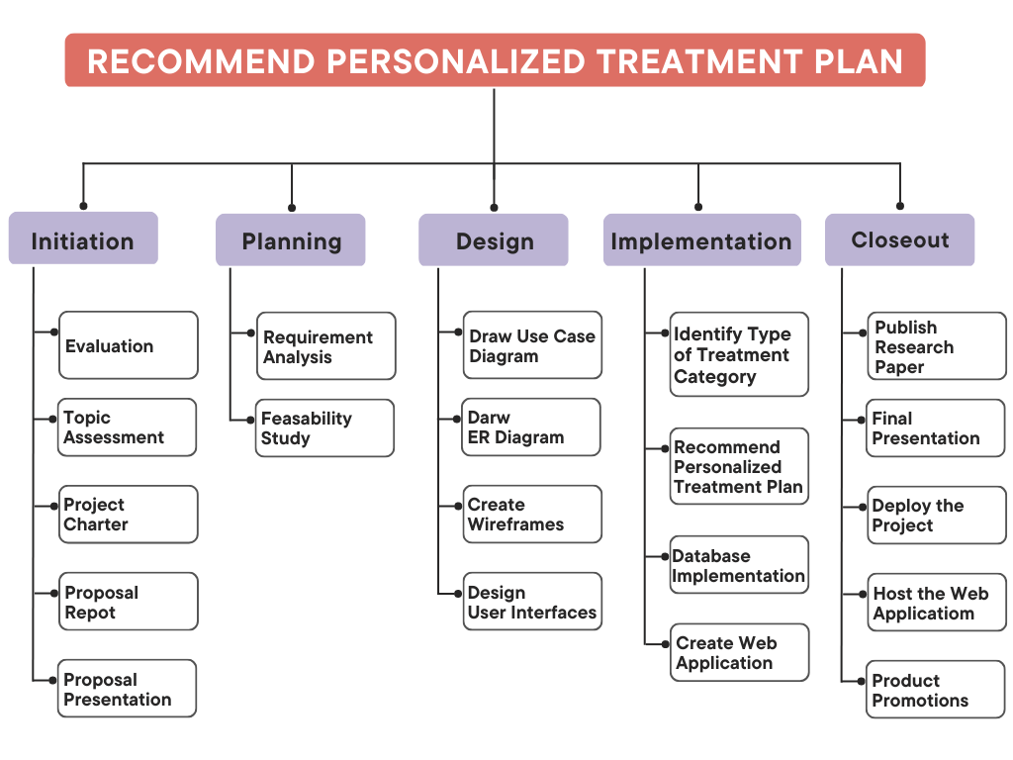
WORK BREAKDOWN STRUCTURE
IT20128722 | R C S Ranasgala | TMP-23-116

Slide 50
GANTT CHART
You can replace the image on the screen with your own work. Just right-click on it and select “Replace image”
IT20128722 | R C S Ranasgala | TMP-23-116

Slide 51
REFERENCES
"Personalized medicine - a patient-centered paradigm." NCBI, https://www.ncbi.nlm.nih.gov/pmc/articles/PMC6256941/.
"Personalized Treatment Plan." WebMD, https://www.webmd.com/cancer/personalized-treatment-plan.
"Personalized Treatment Plans for Cancer Patients." Dana-Farber Cancer Institute, https://www.dana-farber.org/cancer-treatment/personalized-treatment-plans/.
"Creating a Personalized Treatment Plan for Mental Health." Verywell Mind, https://www.verywellmind.com/creating-a-personalized-treatment-plan-for-mental-health-5093461.
CONTRAINDICATIONS
IT20128722 | R C S Ranasgala | TMP-23-116

Slide 52
THANK YOU…

